Slide 1
Lecture 06
Linear Time Sorting
CSE373: Design and Analysis of Algorithms

Slide 2
Sorting Algorithms: Time Complexity
For all the sorting algorithms we have seen so far the worst-case running time is at least O(n log n).
Can we design a sorting algorithm whose worst-case time complexity is less than O(n lg n)?
Sorting Algorithm | Worst Case Time Complexity
Insertion Sort | O(n²)
Merge Sort | O(n lg n)
Quick Sort (randomized/not) | O(n²)
Heap Sort | O(n lg n)

Slide 3
Formal Question
Sorting can be viewed as the process of determining the permutation that restores the order of input numbers.
Input: <7,3,8> => Output: <3,7,8>
We will consider only comparison sorts, algorithms that sort numbers based only on comparisons between input elements.
The sorting methods we have seen so far are all comparison sorts.
We ask: what is the minimum number of comparisons must a comparison sort execute to sort an array of n elements?
To answer this question, we need to learn about decision tree first.

Slide 4
Decision Tree for Comparison Sorts
We think of two outcomes in a comparison of two numbers a and b: a ≤ b and a > b.
For which pair a comparison is done depends only on the outcomes of the comparisons that have been made so far.
So, for each n, the action of a comparison sort on an n-element array can be viewed as a binary tree such that
  each node corresponds to a comparison and
  each leaf corresponds to the permutation that the algorithm outputs.
We call such a tree binary decision tree

Slide 5
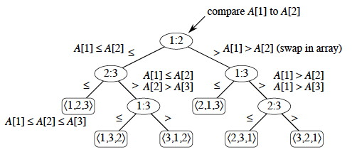
Decision Tree for Comparison Sorts
A binary decision tree for applying a comparison sort algorithm upon a 3-element array: A[1..3]
Can you draw another decision tree for sorting a 3-element array?

Slide 6
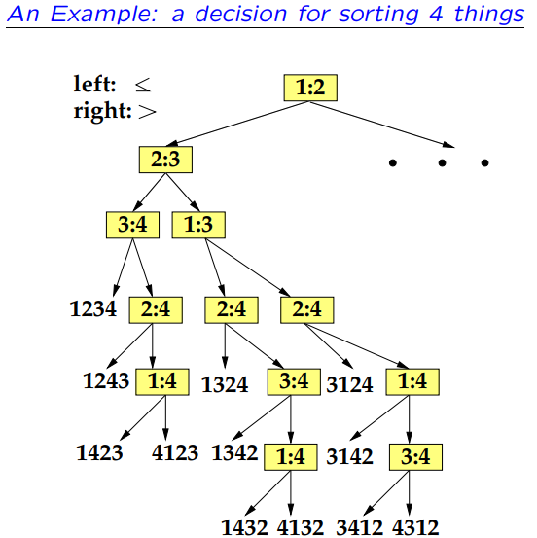

Slide 7
Lower bound on Comparison Sorts
Recall our question: what is the minimum number of comparisons must a comparison sort execute to sort an array of n elements?
Theorem: No comparison sort has the worst-case running time less than O(n lg n).
Proof:
Let’s consider an n-element numeric array: A[1..n] and draw the binary decision tree that results from applying a comparison sort algorithm upon it.

Slide 8
Lower bound on Comparison Sorts
The minimum no. of comparisons (in the worst-case) done by this comparison-sort algorithm
= the length of the longest path from root to a leaf node in the corresponding decision tree
= height of the decision tree = h (let)

Slide 9
Lower bound on Comparison Sorts
Max. no. of leaves in a binary tree with height h, is 2^{h}.
But out binary decision tree contains exactly n! leaves.
n! ≤ 2^{h}
lg(n!) ≤ h
h ≥ lg(n!) = lg (n(n-1)(n-2) …. (n-(n/2-1)) …. 3.2.1)
h ≥ lg (n(n-1)(n-2) …. (n-(n/2-1))
h ≥ lg ( (n/2) (n/2) (n/2)… (n/2))
= lg ( (n/2)^{n/2} )
= (n/2) lg (n/2)
h ≥ O(n lg n)
n/2 numbers, each of them ≥ n/2

Slide 10
Lower bound on Comparison Sorts
So The minimum no. of comparisons (in the worst-case) done by this comparison-sort algorithm = h ≥ O(n lg n)
So the worst-case time-complexity of any comparison-sort is at least O(n lg n) and as such it’s not possible to sort an n-element array in less than O(n lg n) time.

Slide 11
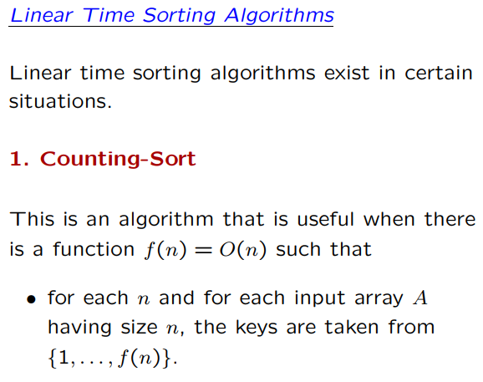

Slide 12
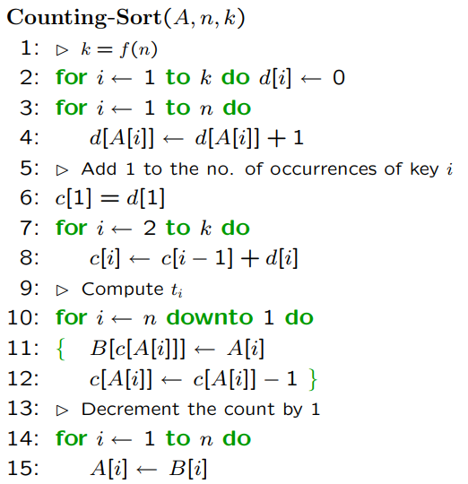

Slide 13
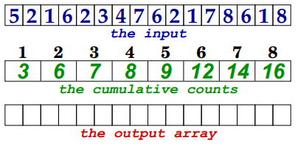
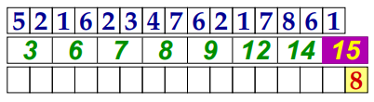
Simulation of Counting Sort
A
d
1 | 2 | 3 | 4 | 5 | 6
7 | 8 | 9 | 10 | 11
12 | 13 | 14 | 15 | 16
B
A
d
B
1 | 2 | 3 | 4 | 5 | 6
7 | 8 | 9 | 10 | 11
12 | 13 | 14 | 15 | 16

Slide 14
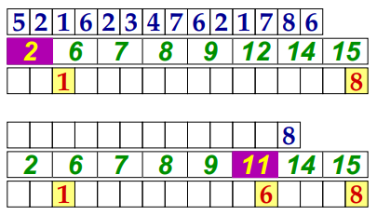
Simulation of Counting Sort
1 | 2 | 3 | 4 | 5 | 6
7 | 8 | 9 | 10 | 11
12 | 13 | 14 | 15 | 16
1 | 2 | 3 | 4 | 5 | 6
7 | 8 | 9 | 10 | 11
12 | 13 | 14 | 15 | 16

Slide 15
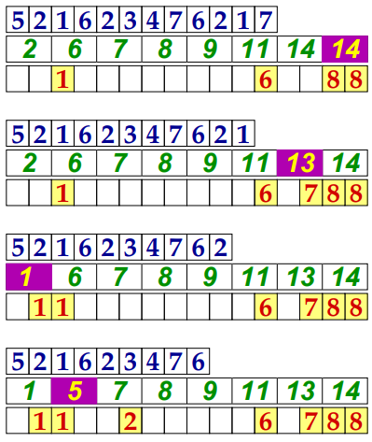
Simulation of Counting Sort
1 | 2 | 3 | 4 | 5 | 6
7 | 8 | 9 | 10 | 11
12 | 13 | 14 | 15 | 16
1 | 2 | 3 | 4 | 5 | 6
7 | 8 | 9 | 10 | 11
12 | 13 | 14 | 15 | 16
1 | 2 | 3 | 4 | 5 | 6
7 | 8 | 9 | 10 | 11
12 | 13 | 14 | 15 | 16
1 | 2 | 3 | 4 | 5 | 6
7 | 8 | 9 | 10 | 11
12 | 13 | 14 | 15 | 16

Slide 16
Time Complexity of Counting Sort
//O(k)
//O(n)
Total time complexity of counting sort, T(n) = O(n+k), where
n = no. of elements in input array and
k = largest element in input array
So if k is O(n²) then T(n) = O(n²)
i.e. counting sort is linear only when the largest element in input array is linear in order
//O(k)
//O(n)
//O(n)

Slide 17
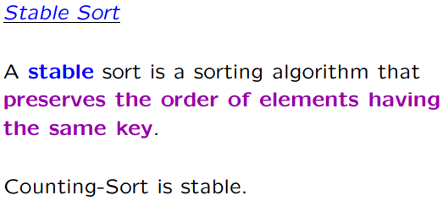

Slide 18
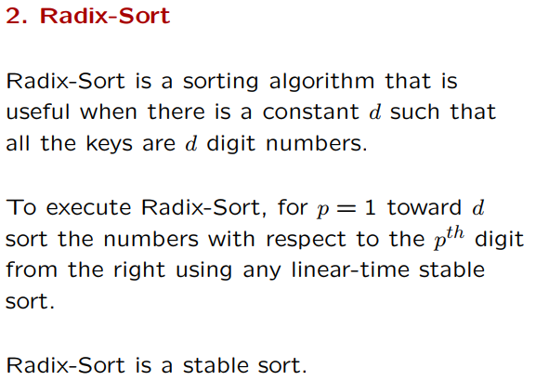

Slide 19
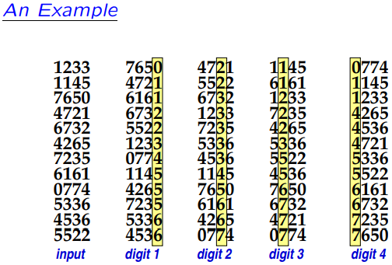

Slide 20
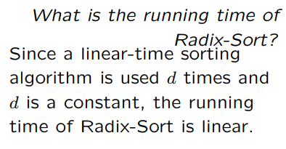

Slide 21
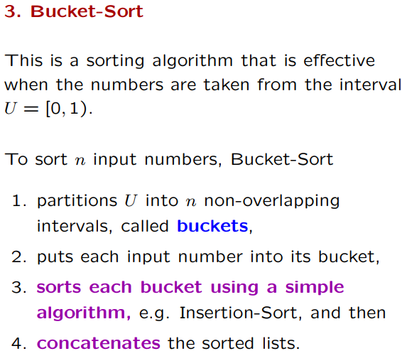

Slide 22
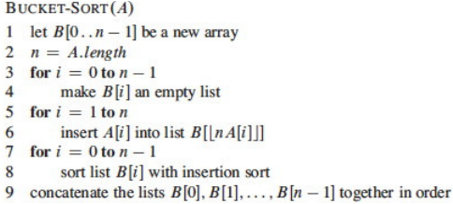

Slide 23
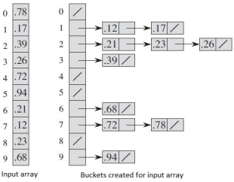
.17
.12
.26
.21
.23
.78
.72
Radix Sort Simulation (before sorting the buckets/linked-lists)

Slide 24
Radix Sort Simulation (after sorting the buckets/linked-lists)

